Slide 1

Analysis Made By: Marwan Mostafa
This Photo by Unknown Author is licensed under CC BY-SA-NC

Slide 2
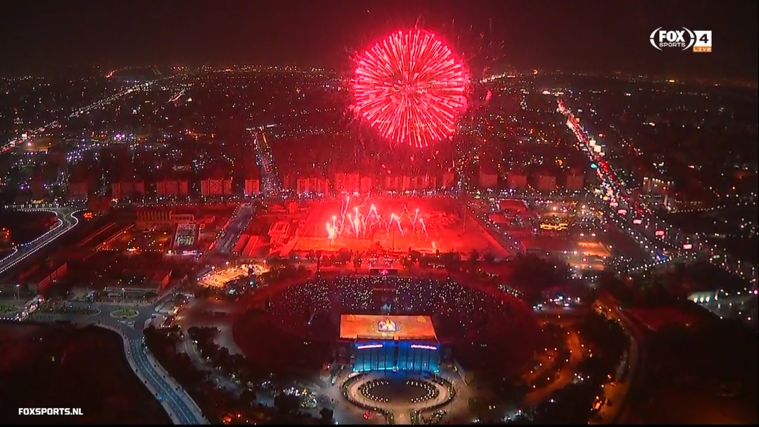
Group Stage

Slide 3
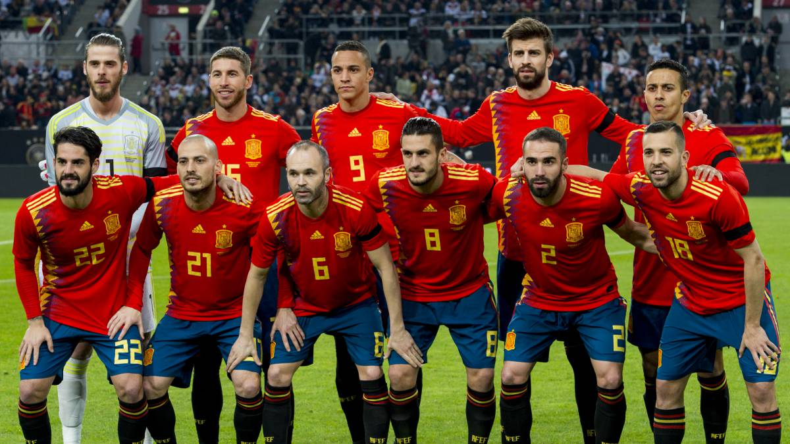
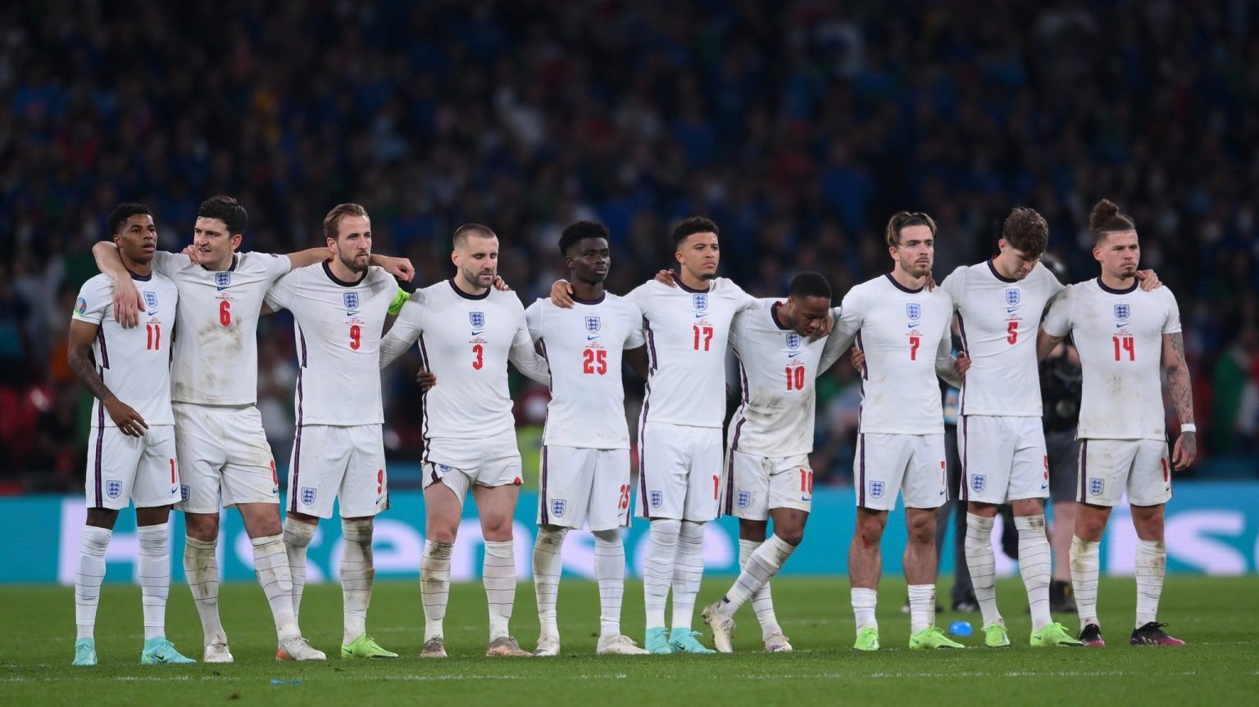
Most Goals In Group Stage
This Photo by Unknown Author is licensed under CC BY-SA-NC
Spain & England scored the greatest number of goals in group stage with total of 9 goals.

Slide 4

Most Conceded Goals
Costa Rica conceded the greatest number of goals in group stage (and in whole tournament) with total of 11 goals.

Slide 5
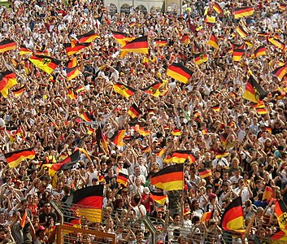
Most Number Of Expected Goals
Germany had the greatest number of expected goals in 1 match with a value of 10.1 goals.

Slide 6
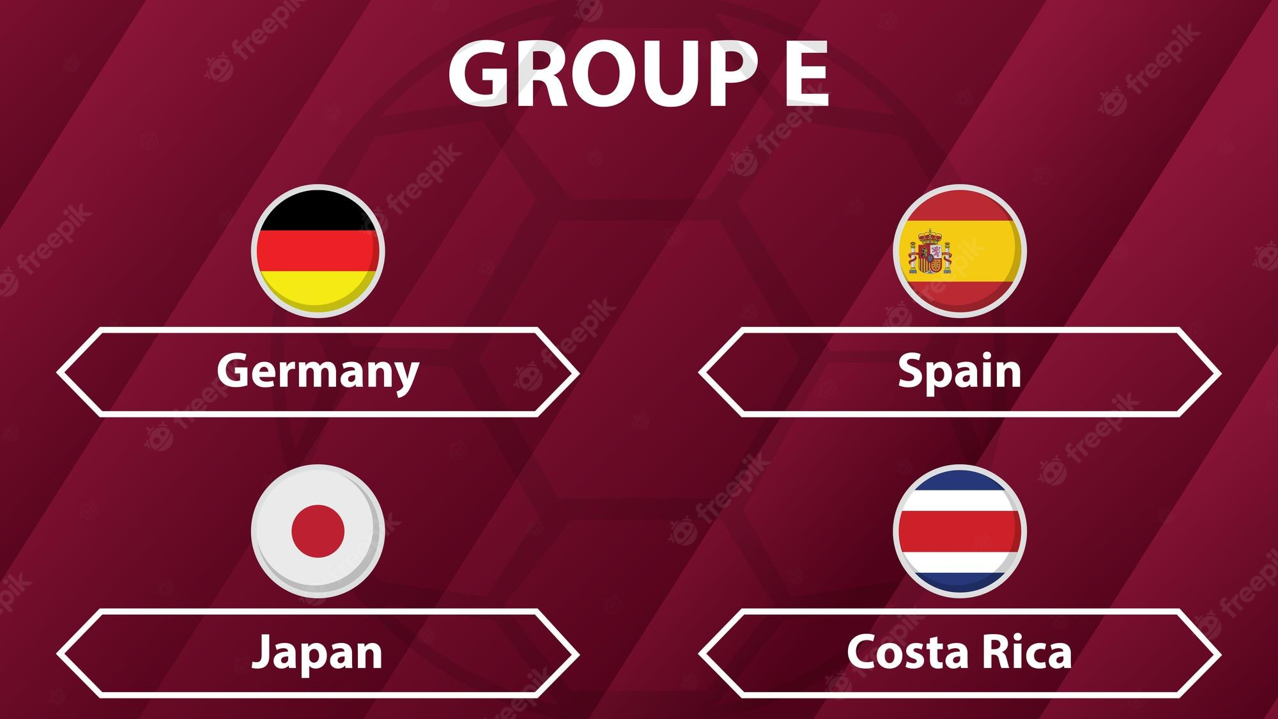
Group E had the greatest number of goals in group stage with total of 22 goals.

Slide 7
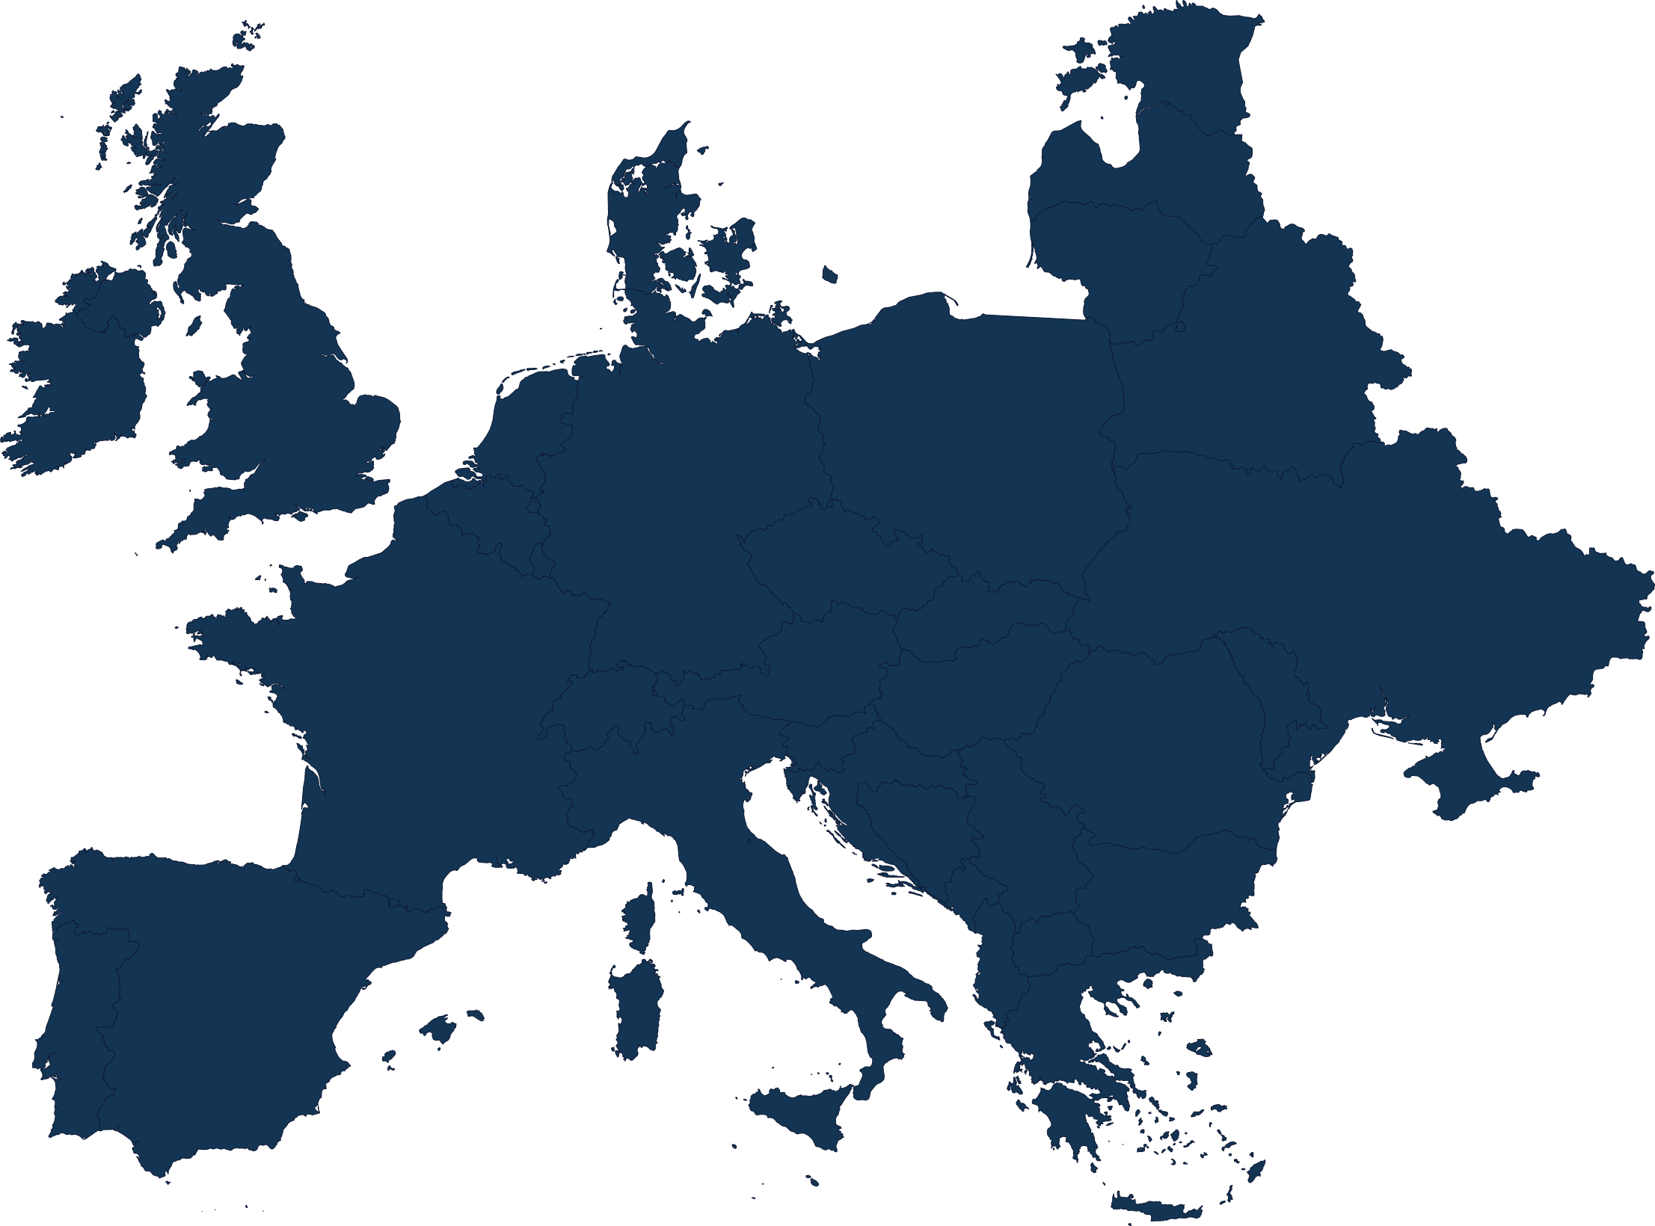
Doing It All
European teams are the most teams that scored goals in the group stage, and the most teams that conceded goals as well.

Slide 8
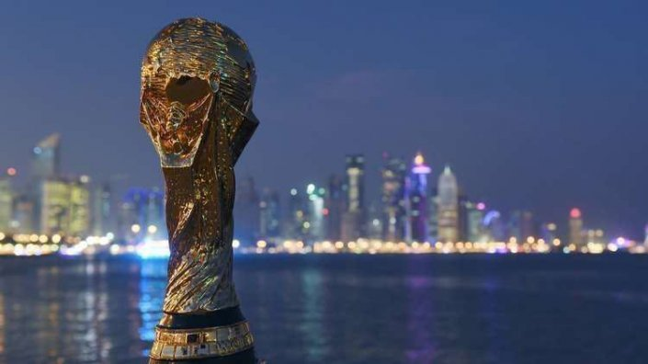
Whole Tournament

Slide 9
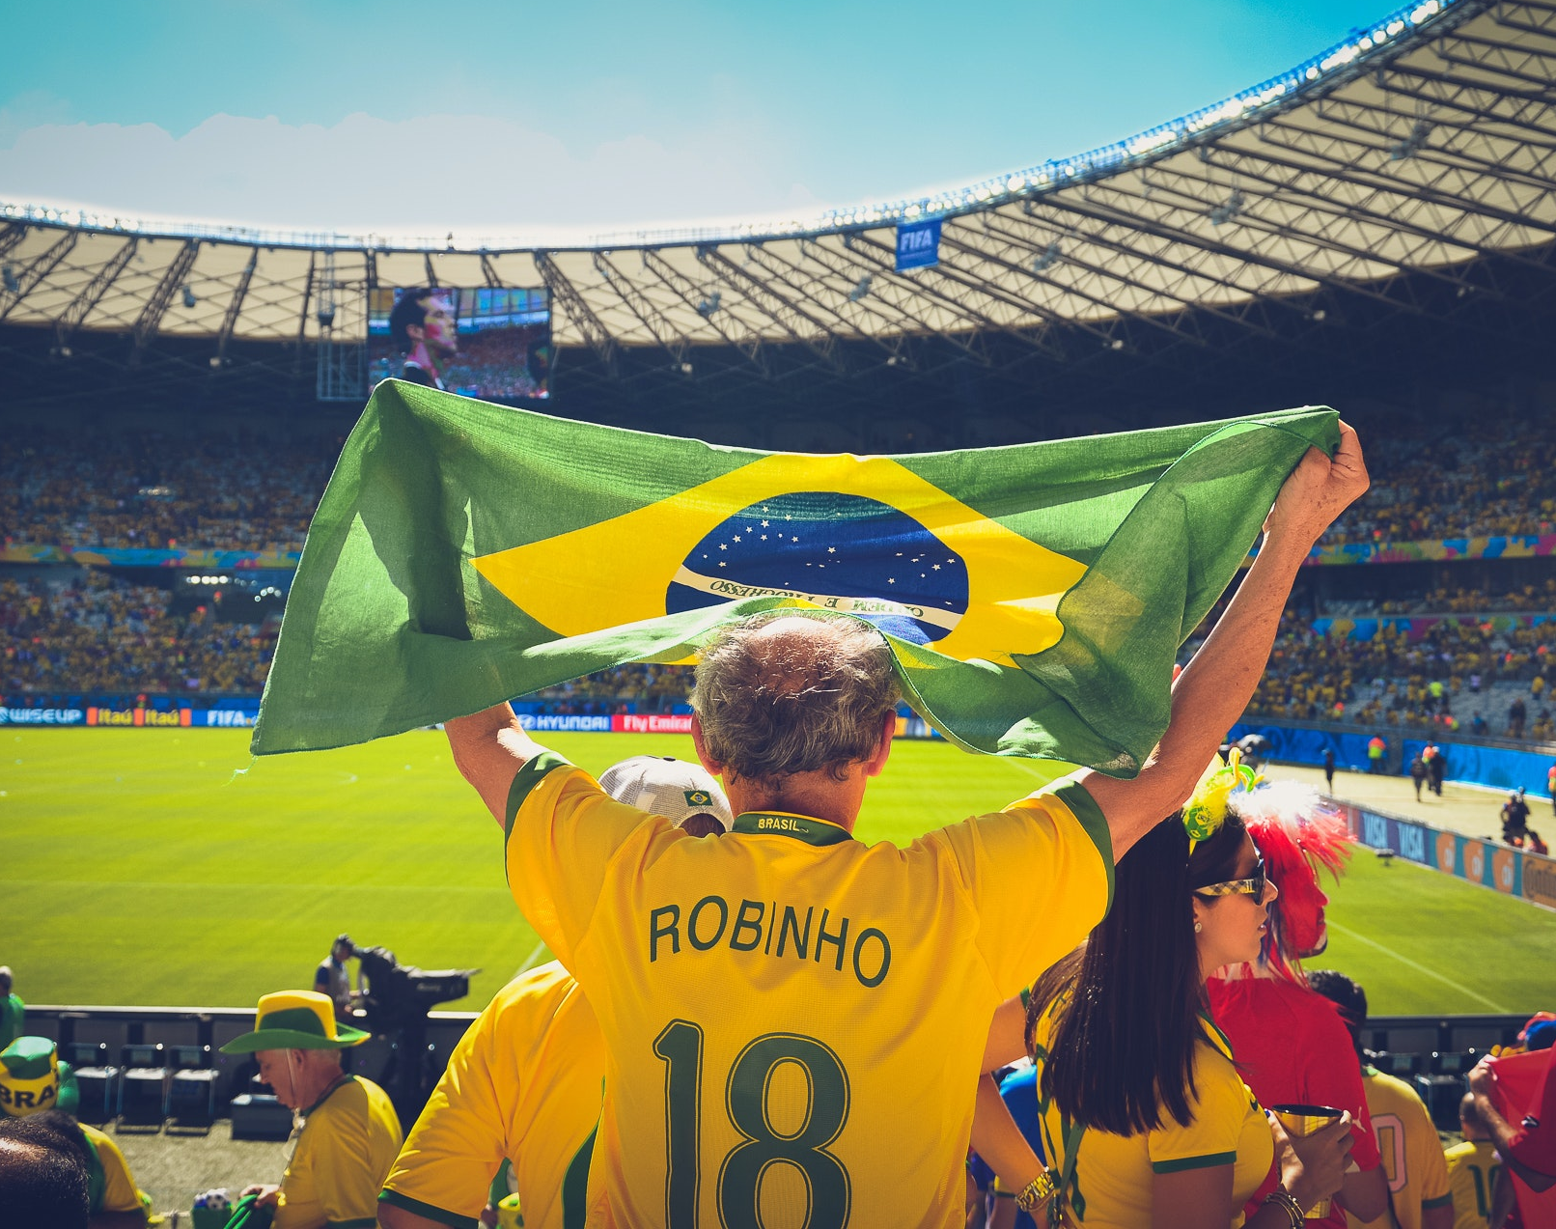
So Many Options!
Brazil is the most team that used players in the world cup with total number of 26 players.

Slide 10
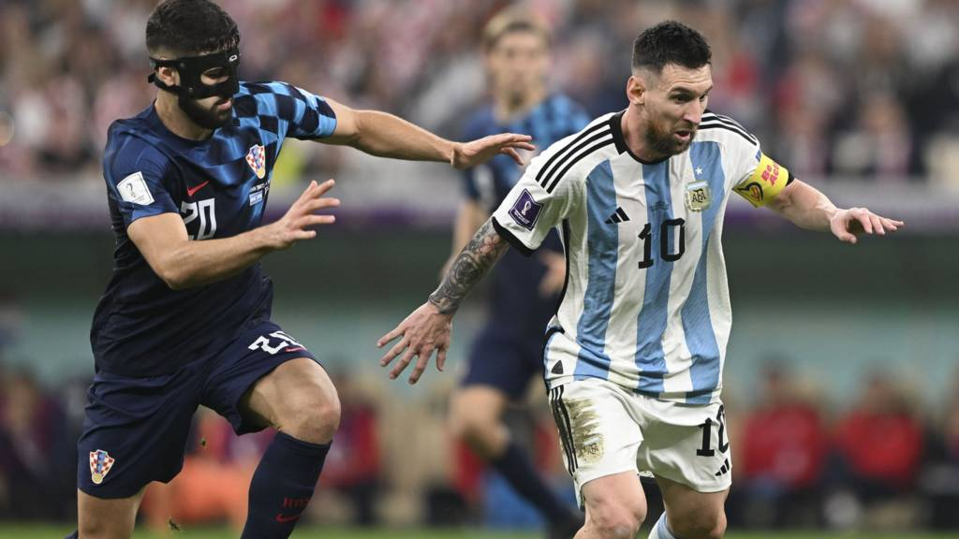
Need More Energy
Argentina & Croatia are the most two teams that played minutes in the world cup with total of 690 minutes.

Slide 11
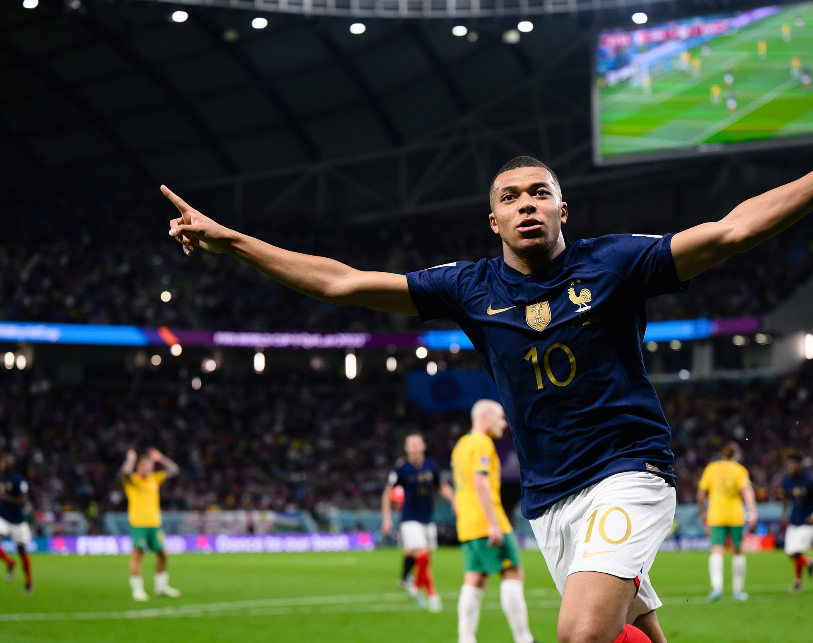
GOALS! GOALS! GOALS!
France is the most team that scored goals in the whole tournament with total of 16 goals (14 non-penalty)

Slide 12
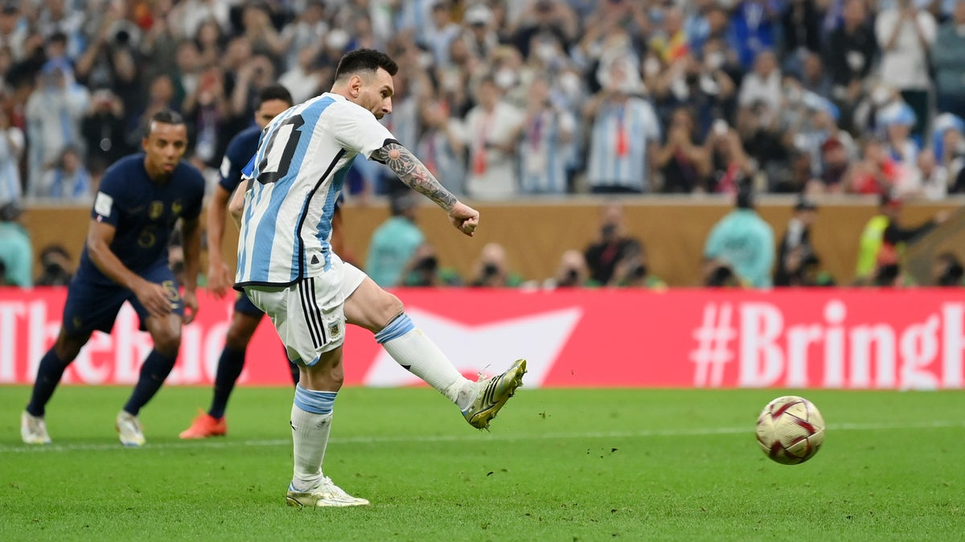
From The Spot
Argentina had the greatest number of penalties in the tournament with total of 5 penalties. They scored 4 of them.

Slide 13
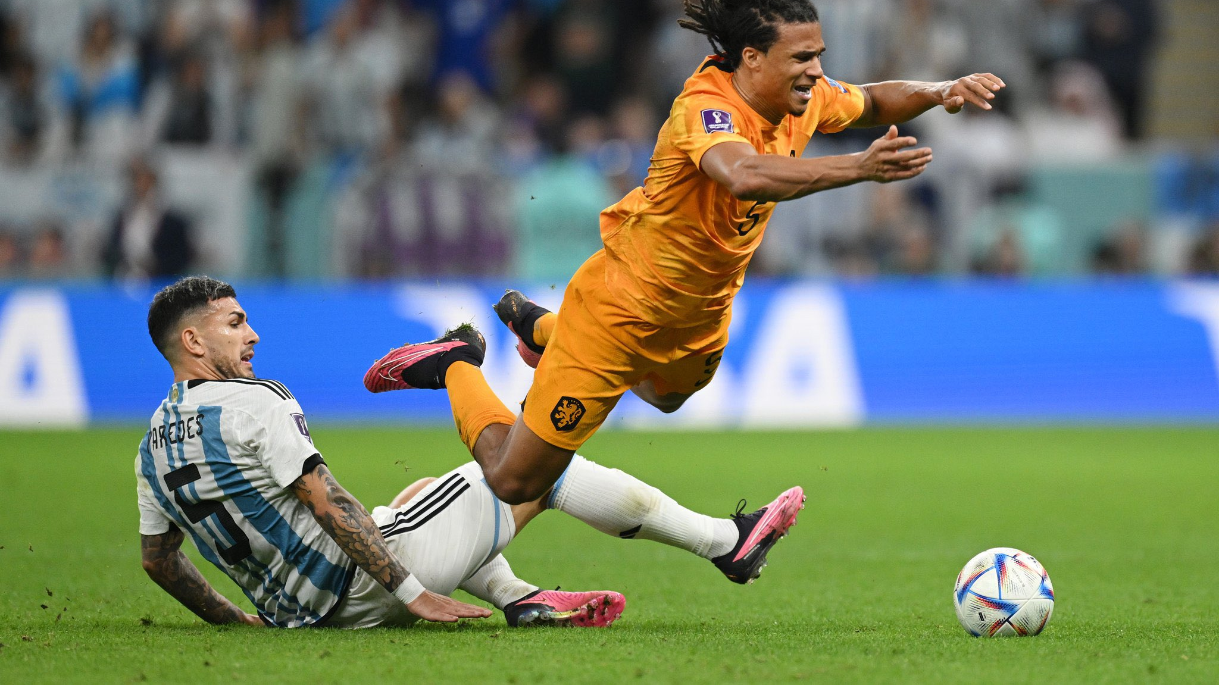
Yellow!
Argentina is the most team that took yellow cards in the whole tournament.

Slide 14
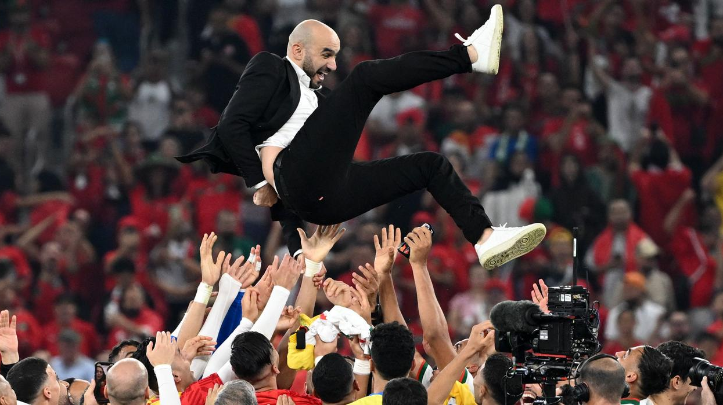
Sorry! We Are Closed.
Morocco is the most team that had clean sheets in the whole tournament with total of 4 clean sheets.

Slide 15
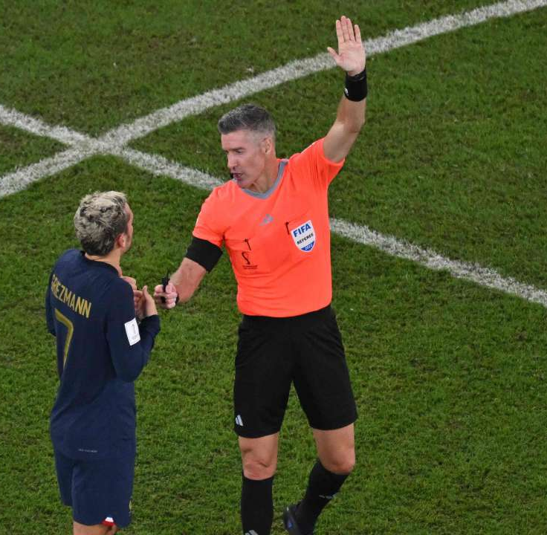
Busted!
France is the most team that had penalties against with a total of 4 penalties. 3 were scored and 1 was missed.

Slide 16
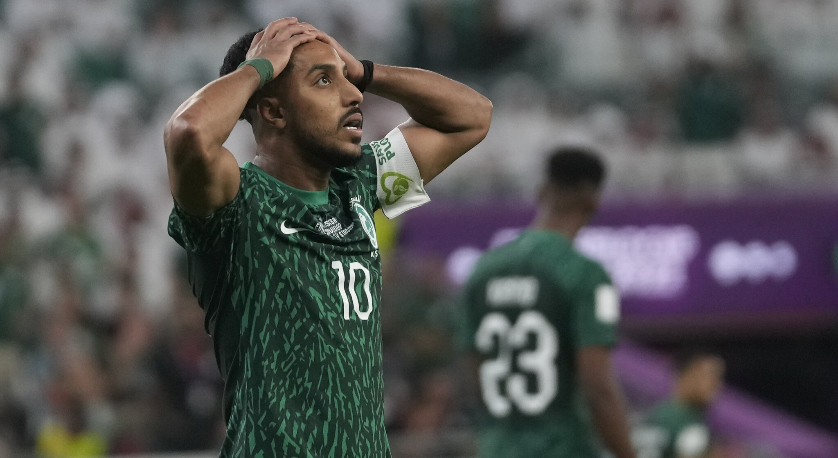

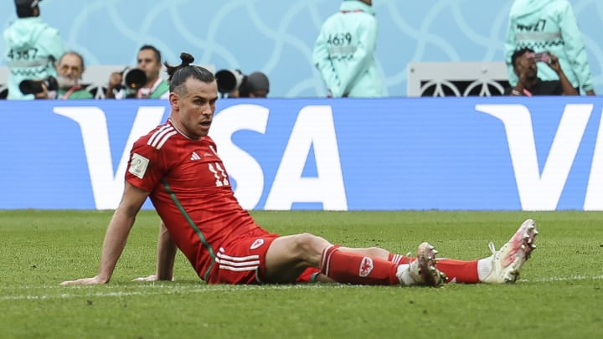
Couldn’t Save It
Wales & Saudi Arabia are the only 2 teams that conceded freekick goals in the tournament.

Slide 17
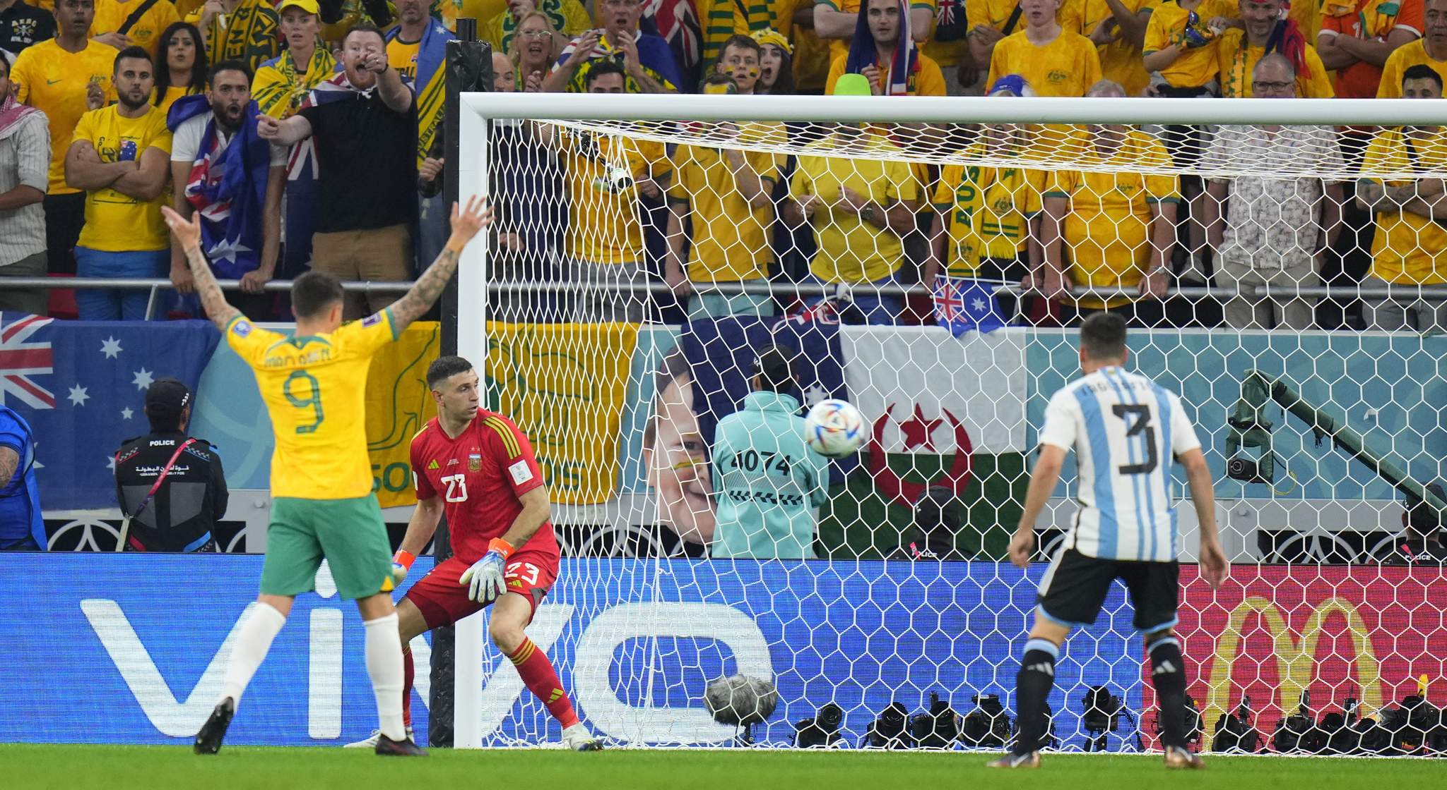
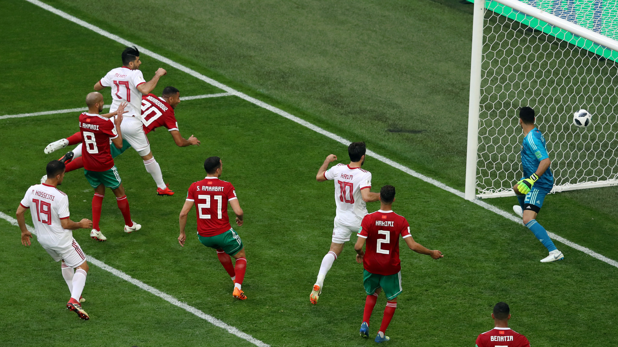
By Fault
Morocco & Argentina are the only two teams that conceded own goals in the tournament.

Slide 18
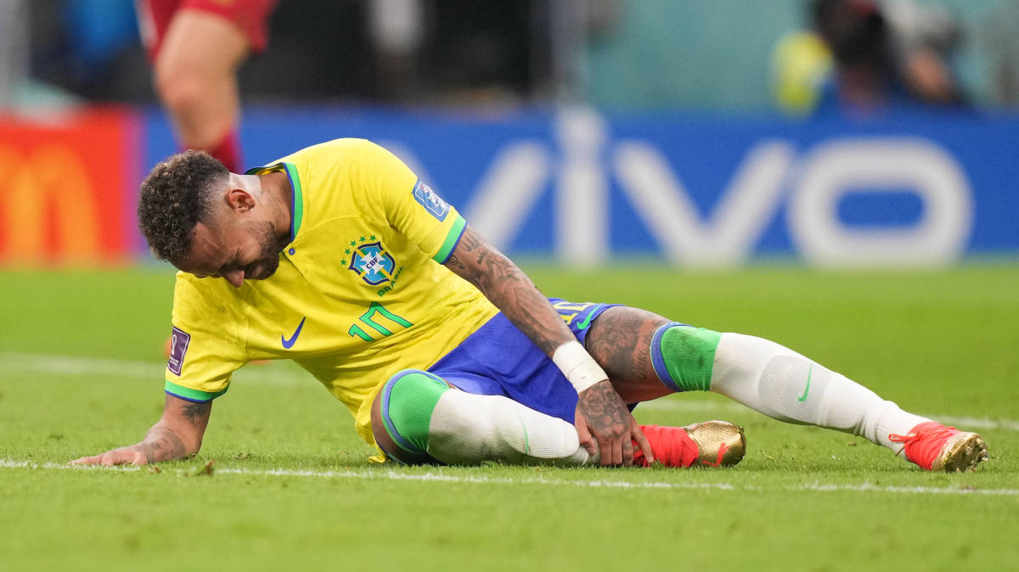
Free Kicks
Brazil is the most team that had free kicks in the tournament with a total of 7 free kicks.

Slide 19
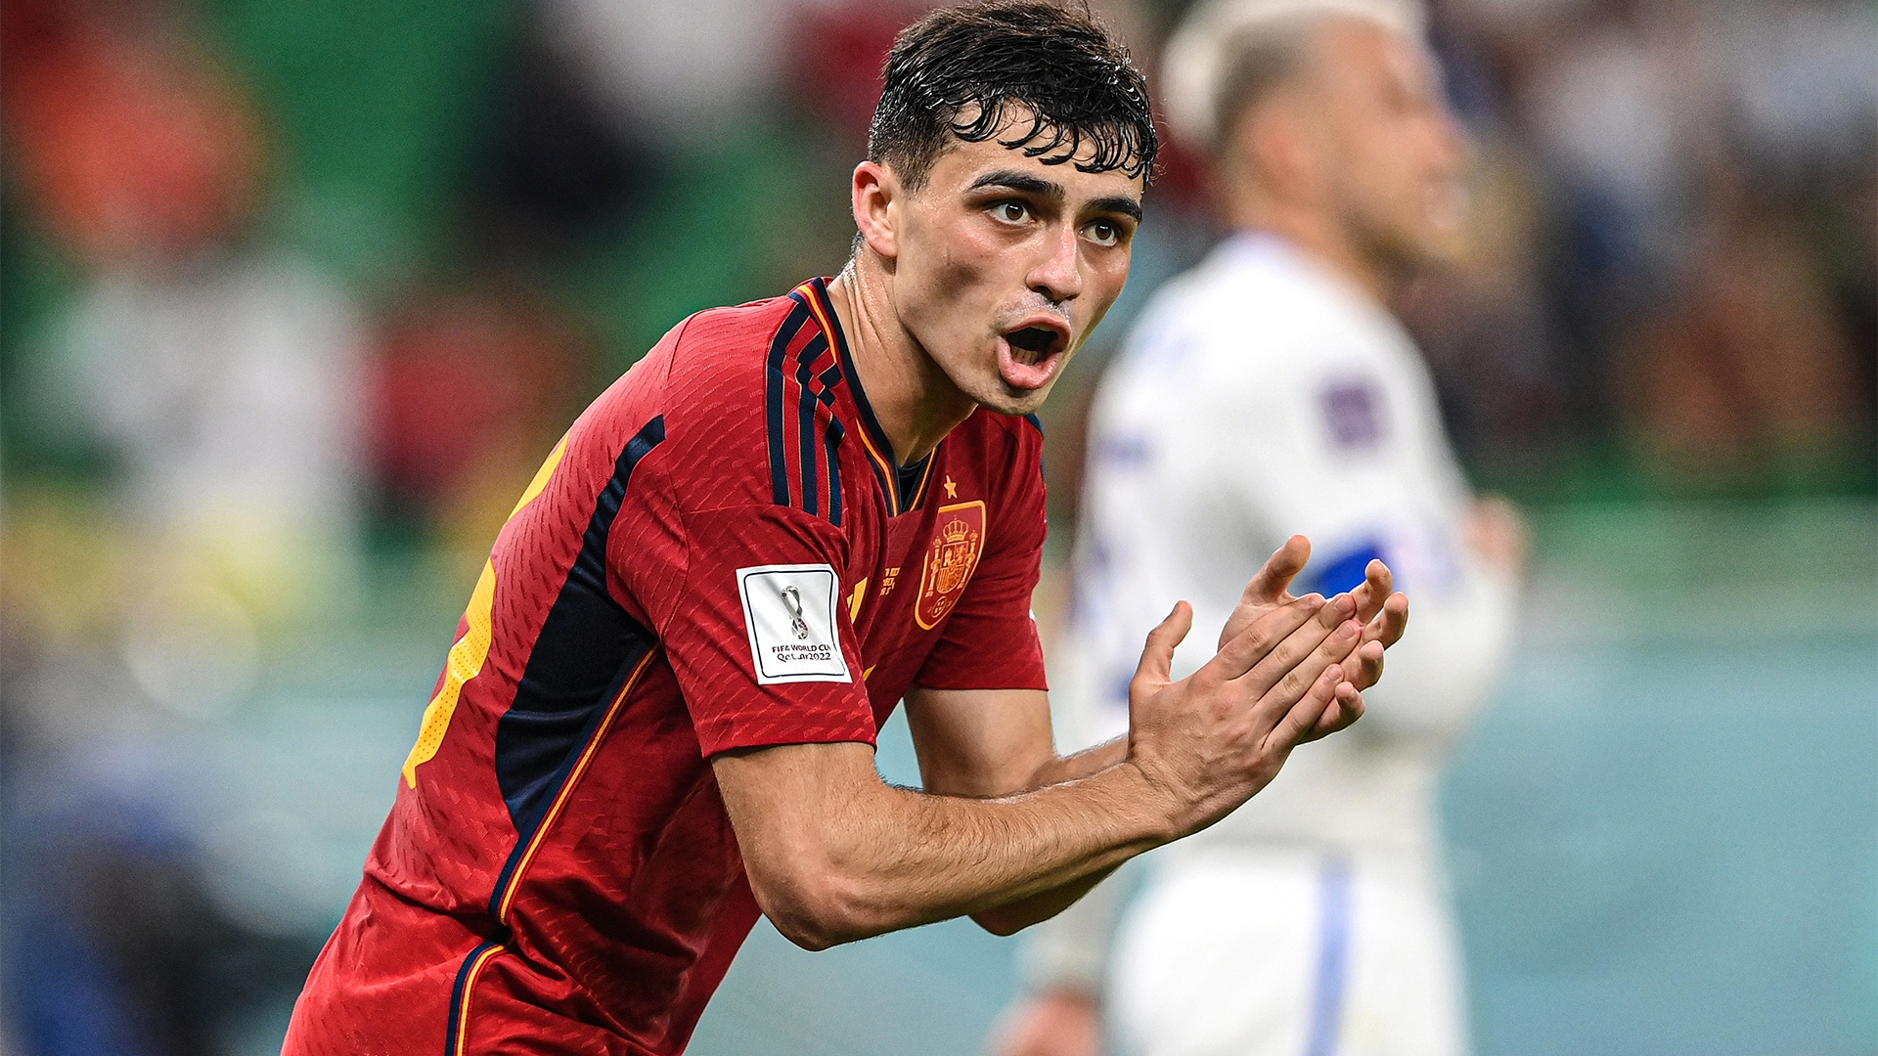
Spain is the most team that made through passes in the whole tournament with a total of 11 through passes.

Slide 20
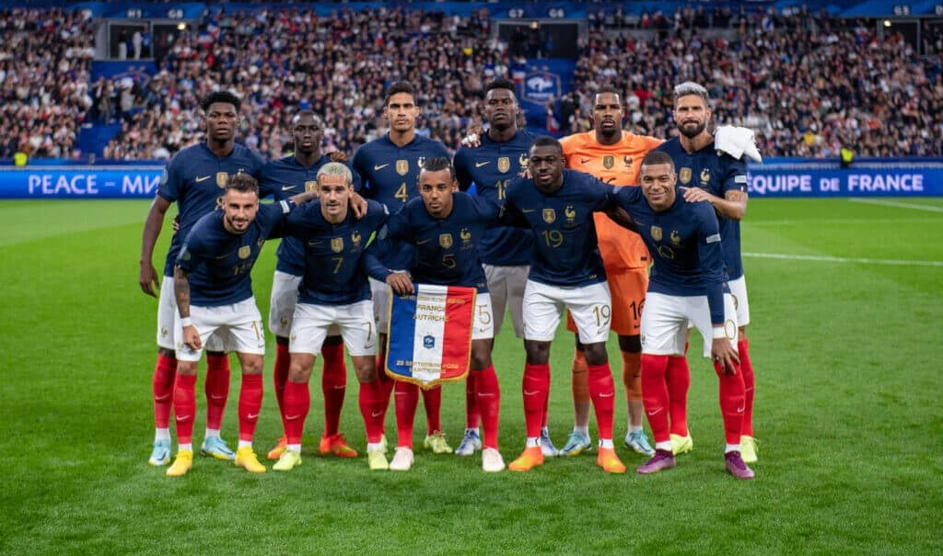
Inside the field
France has the highest number of shots in the tournament. But not the highest number of shots on target is it’s done by Argentina and Brazil.
France is the most team that made passes that lead to a shots.
France is the most team that made tackles.
France is the most team that made tackles in the defensive third.
France is the most team that made dribbles
France is the most team that won air balls.
France is the most team that made interceptions.

Slide 21
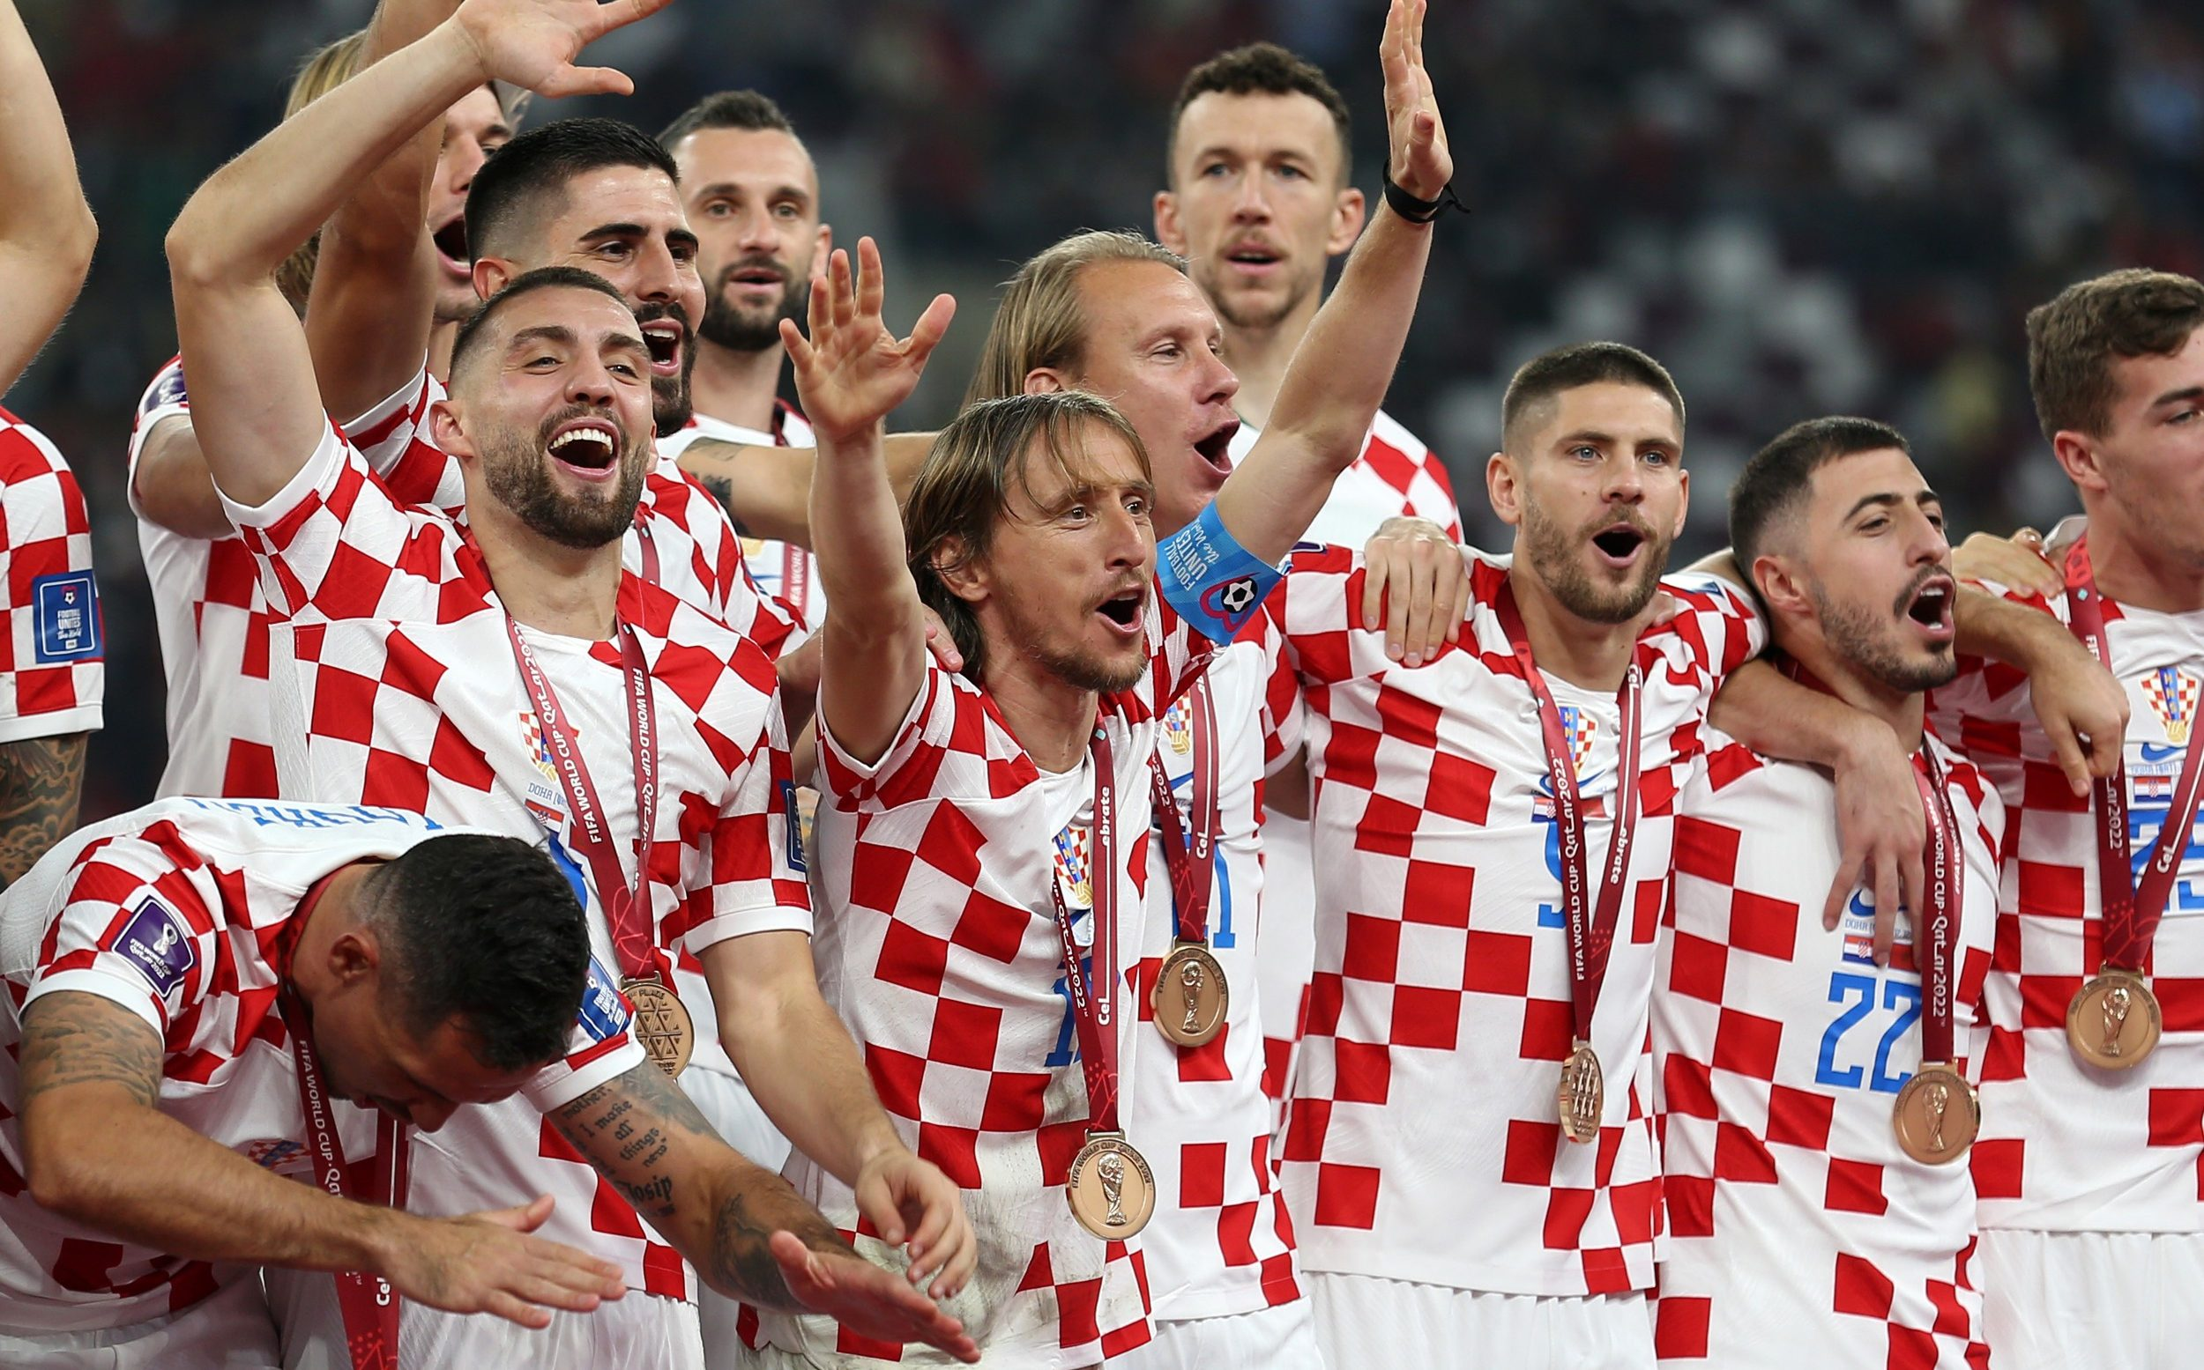
Inside The Field
Croatia is the most team that made crosses (inside and outside penalty area)
Croatia is the most team that played through ins.
Croatia is the second-most team that made touches in the middle third.
Croatia is the most team that made tackles in the middle third.
Croatia is the most team that recovered ball after being lost.
Croatia is the most team that blocked shots.

Slide 22
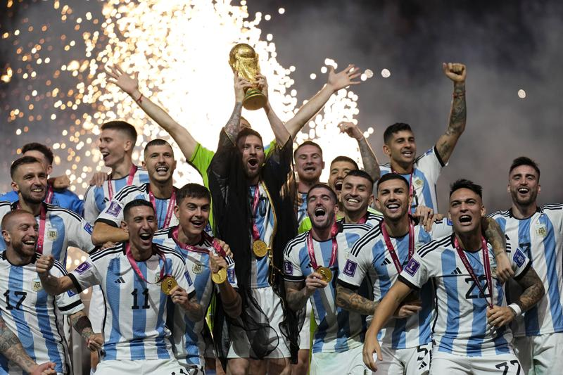
Inside The Field
Argentina is the most team that made passes.
Argentina is the most team that made passes to penalty area.
Argentina is the most team that played corners.
Argentina is the most team that made offsides.
Argentina is the most team that touched the ball in the middle third.
Argentina is the second-most team that made tackles in the defensive third.
Argentina is the most team that lost the ball.
Argentina is the most team that lost air balls.
Argentina is the most team that committed fouls.
Argentina is the most team that won fouls.
Argentina is the most team that blocked passes.

